Slide 1
The “observing self” as a necessary condition for conscious experience.
--- or, why complicate things with “self” when “consciousness” is tough enough?
Bernard J. Baars
The Neurosciences Institute
San Diego
www.nsi.edu/users/baars
References are online at NSI website
www.sci-con.org

Slide 2
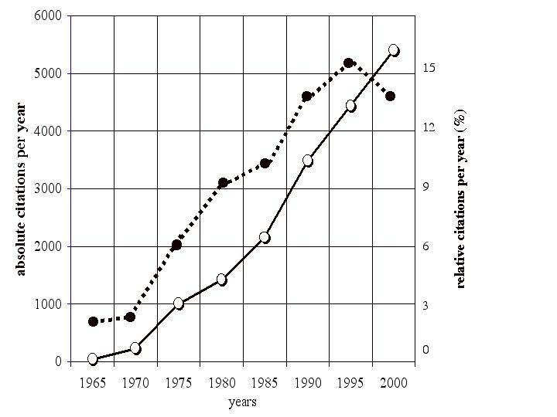
“Rediscovery” of consciousness since 1960s…
Citations per year in biomedical journals
In the last 10 years we have seen new scientific journals, international societies and conferences.
Consciousness & Cognition from Academic Press/Elsevier.
ASSC (Assn for the Scientific Study of Consciousness) annual conferences in Europe and North America.
Journal of Consciousness Studies in the UK.
Psyche on the web.
Science & Consciousness Review (scientific news reports) at www.sci-con.org.
Height of
Behaviorism
Absolute citations/yr
Consns/behavioral/yr

Slide 3
Flow of some ideas on consciousness.
PSYCHOLOGY
COMPUTER SCIENCE & MATHS
Baars, GW applied to
consciousness.
Dehaene et al, GW & nn
(PNAS, 2003)
Newell et al, Global Workspace architectures
Franklin, conscious GW applied to IDA
Neural Darwinism
Edelman & Tononi
Dynamical systems
Walter J. Freeman
PHILOSOPHY
2600 years of history!
Insistence on subjectivity
BRAIN SCIENCES

Slide 4
The main global workspace hypothesis, the Conscious Access Hypothesis:
“Consciousness enables global access to multiple brain capacities, which otherwise function separately.”
Implications:
Self Hypothesis: ”Executive systems in the brain also gain access to conscious input.”
Strongest Self Hypothesis: “Phenomenal consciousness is the flow of information to executive interpretation in the brain.”
REFERENCES: (available at www.nsi.edu/users/baars)
Baars, B.J. (2002) The conscious access hypothesis: Origins and recent evidence. Trends in Cognitive Sciences, February.
Baars, B.J. & Franklin, S. (2003) How conscious experience and Working Memory interact. Trends in Cognitive Sciences.
Baars, B.J. et al (in press) Brain, conscious experience, and the observing self. Trends in Neurosciences.
    Baars, B.J. (1988) A Cognitive Theory of Consciousness. NY: Cambridge University Press.

Slide 5
A number of authors now agree on the basic “global workspace” hypothesis.
Daniel C. Dennett: “"Theorists are converging from different quarters on a version of the global neuronal workspace model of consciousness…” (2001)
Crick & Koch (2003) “…conscious experiences are sustained by shifting coalitions of neurons … at any moment, the winning coalition is somewhat sustained, and embodies what we are conscious of.”
J.W. Cooney & M.S. Gazzaniga (May, 2003) “In the workspace model, outputs form an array of parallel processors (that) continually compete for influence … (giving) rise to a coherent network state in which the integrated information is widely available … (and which) determines the contents of the subjective experience…” (p. 162)
DeHaene & Naccache, 2001: “We propose a theoretical framework … the hypothesis of a global neuronal workspace. …(this) is what we subjectively experience as the conscious state.”
Similar ideas from Gerald Edelman & Tononi, Damasio, Llinas, W.J. Freeman, ER John, and others.

Slide 6
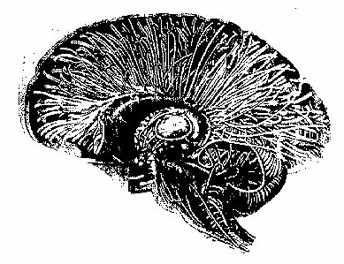
The thalamo-cortical system even looks like a global distribution system.
Many scientists have pointed out how this looks like a natural way to integrate and distribute information.
All regions of cortex connect to “mirror image” areas in the thalamus.
Damage to certain thalamic centers (ILN) results in a loss of consciousness --- so we know they are needed for waking consciousness.

Slide 7
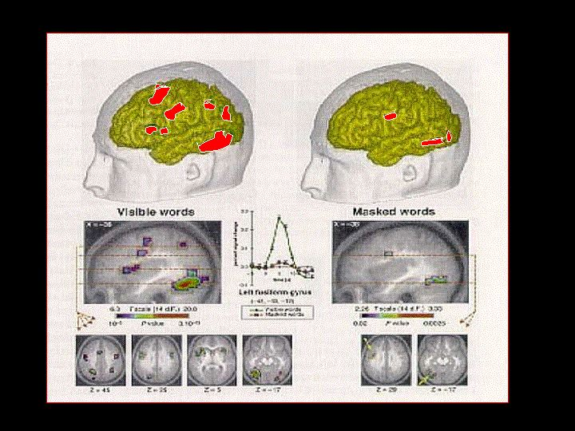
Results of Dehaene’s (2001) experiment:
Conscious vs. Unconscious visual words.
Masked words activate visual cortex.
The same words, when they are conscious, also spread forward to activate regions in parietal and frontal cortex.
This basic finding has now been repeated in vision, touch, hearing, pain perception, and sensorimotor tasks. Using fMRI, MEG, EEG, PET, local implanted electrodes, etc.
Empirically, therefore, conscious events activate far more areas of cortex than matched unconscious ones. “Global broadcasting?”
Conscious Unconscious

Slide 8
Another way to look at consciousness is as “information supplied to executive interpreters in the brain.”
Carefully diagnosed cases of self alteration in identity --- in Dissociative Identity Disorder, fugue, high-level hypnosis, and even imaginative identification --- are marked by spontaneous reports of "time loss" --- a loss of reported access to conscious events.
In the case of fugue and DID, the eclipsed self reports time loss, but the dominant self can access the lost time. (E.g., accountant)
A similar dissociation can be found in split brain patients, with each hemisphere exercising executive control over one side of the body, based on conscious input limited to half of the visual field.
Implication: Self functions may be a necessary condition for consciousness as well.
l
Alteration of personality with loss of
Inhibitory control: Phineas Gage,
Reconstructed by Hannah Damasio et al.

Slide 9
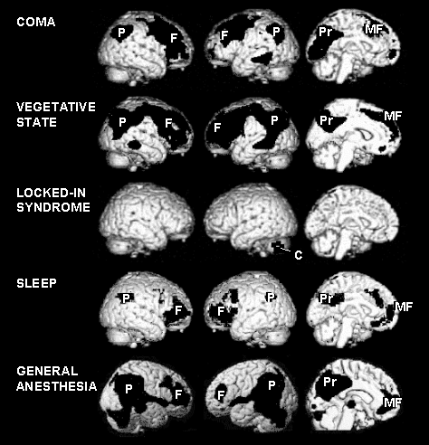
Is the self not at home when consciousness is lost?
Metabolic differences between waking versus unconscious states.
(from Baars, Ramsoy & Laureys, TINS, in press)
Notice strikingly lower PET metabolism in coma-vegetative state, anesthesia and sleep.
But not necessarily in sensory areas that are believed to directly underlie conscious vision, audition, inner speech, and visual imagery.
Notice normal activity in the conscious “locked in syndrome.” (= behaviorally unconscious)
Across very different etiologies, the drop in metabolic activity consistently occurs in fronto-parietal regions.

Slide 10
These are the regions of cortex that seem to underlie the sensorimotor self and the personality self.
Particularly:
Right parietal regions for unconscious egocentric/ allocentric visual frames and body “ownership”.
Prefrontal cortex for inhibition of impulses. (e.g. conscientiousness, planning).
All have high activity in resting conscious states (Raichle, Mazoyer).

Slide 11
Self may be seen as the long-term, dominant context of conscious experience.
Self is contextual in GW terms, because people are unaware of it, yet it still shapes conscious contents.
Context of visual perception - the perspective of the observer.
Context of action and motivation - personality. “shoulds.”
Self is not necessarily known - not “objects” of consciousness.
From Baars (1988) A cognitive theory of consciousness. www.nsi.edu

Slide 12

Was Proust right?
On being half-awake early in the morning:
“… then I lost all sense of the place in which I had gone to sleep, … I could not be sure at first who I was; … but then memory ... would put together by degrees the component parts of my ego.”
Swann’s Way, Vol. 1,
A la Recherche des Temps Perdus
Implication: sleep abolishes not only consciousness, but also the observing self.

